Slide 1
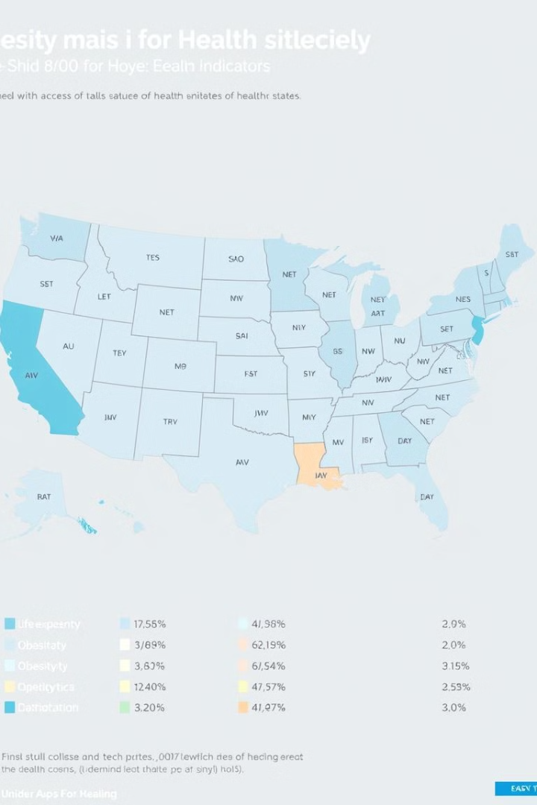
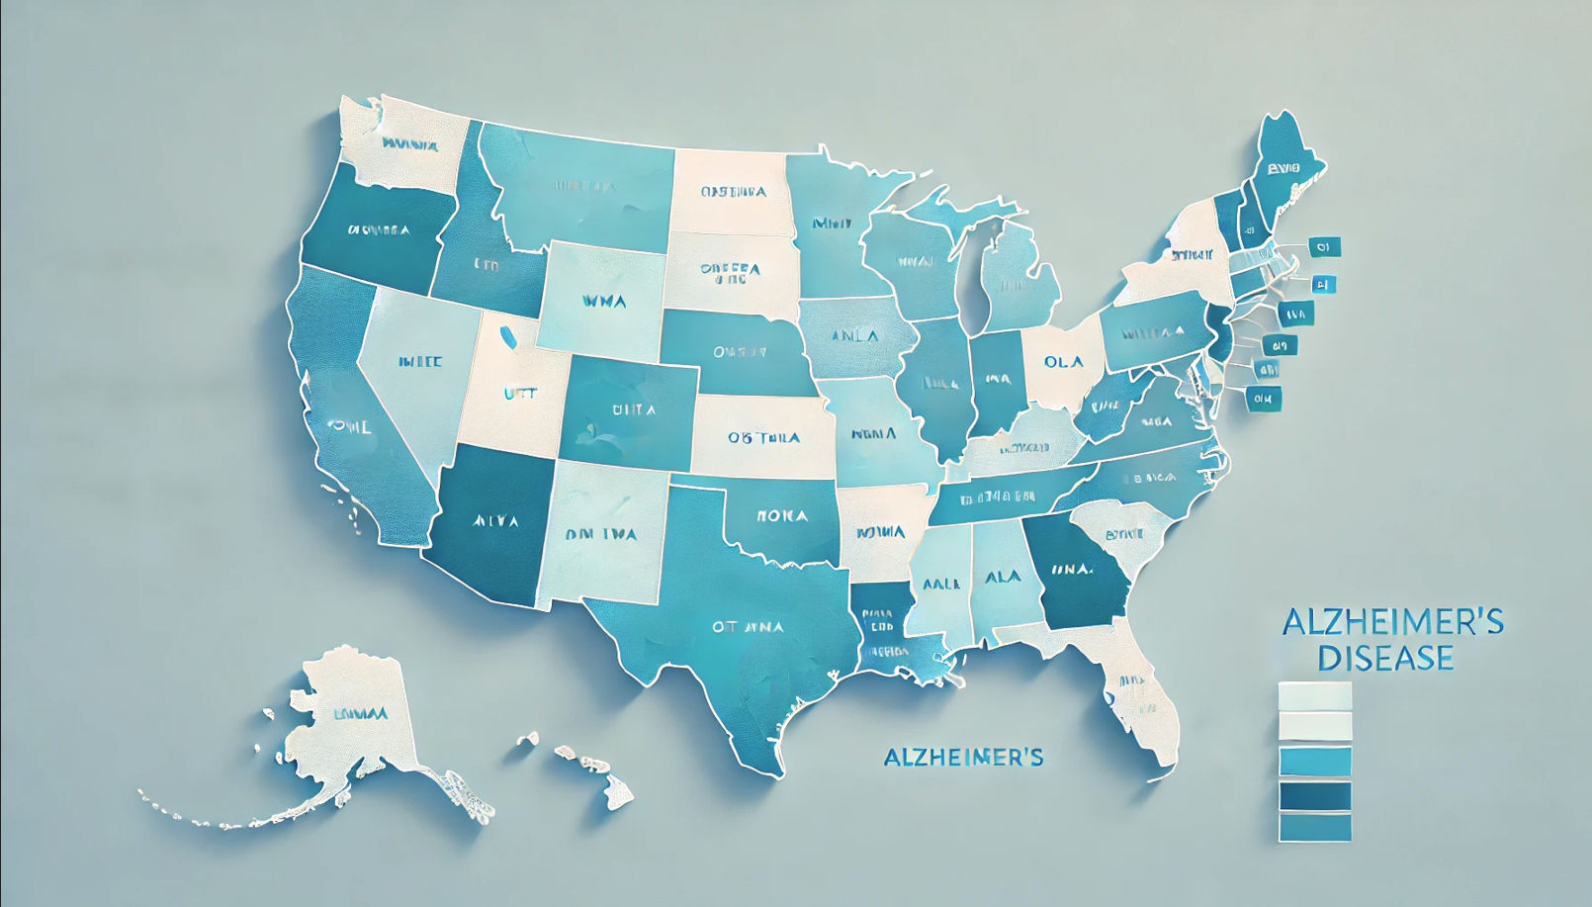
Exploratory Data Analysis
Alzheimer’s Disease and Healthy Aging
Trends in the U.S.
Examining health metrics across US states and territories.
Insights for targeted interventions and policy development.
by Jose Pantaleon

Slide 2
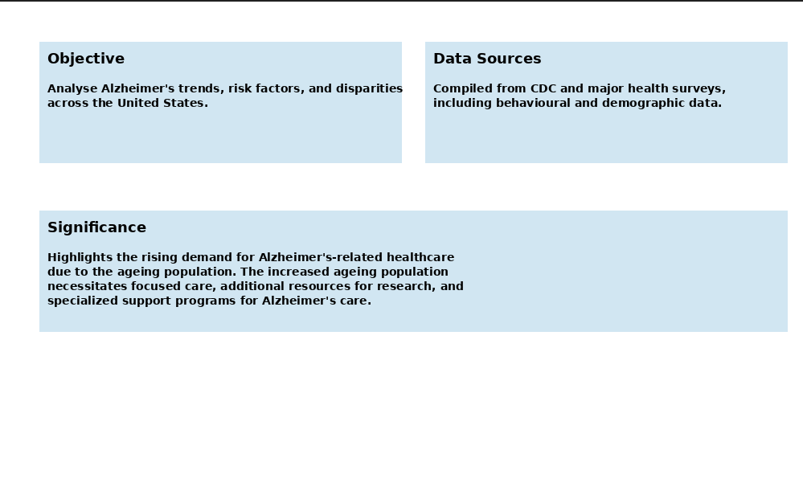

Project Overview and Significance

Slide 3
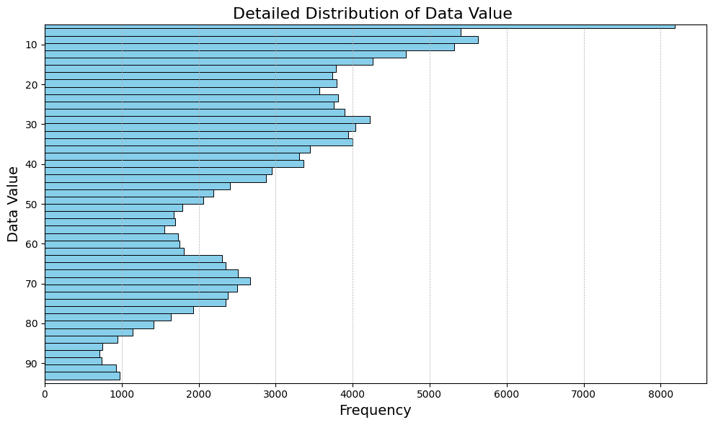
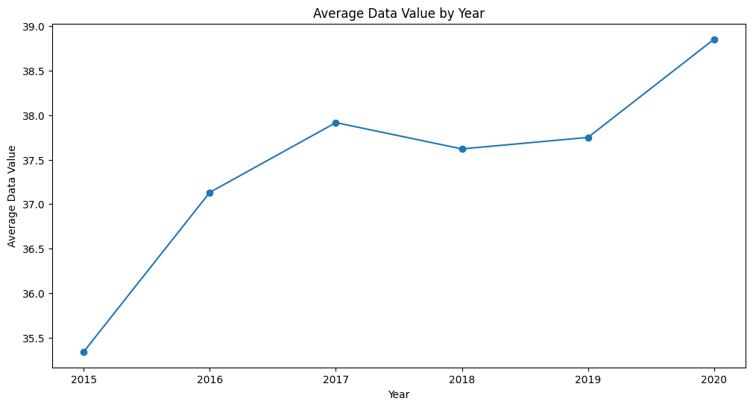
Distribution of Data Value
Upward Trend
Average data value increased from 2015 to 2020,
indicating potential rise in Alzheimer's-related issues.
Implications
Suggests growing health concerns as the population ages,
requiring adaptive resource allocation.
Future Projections
If trend continues, healthcare systems may face increased pressure
in coming years.

Slide 4
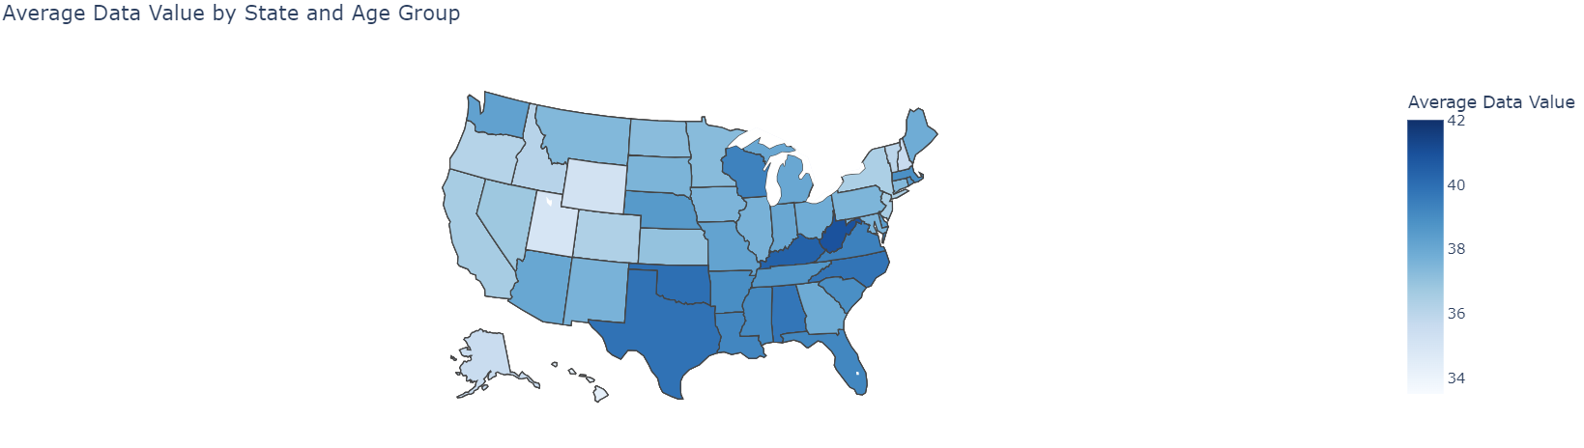

Slide 5
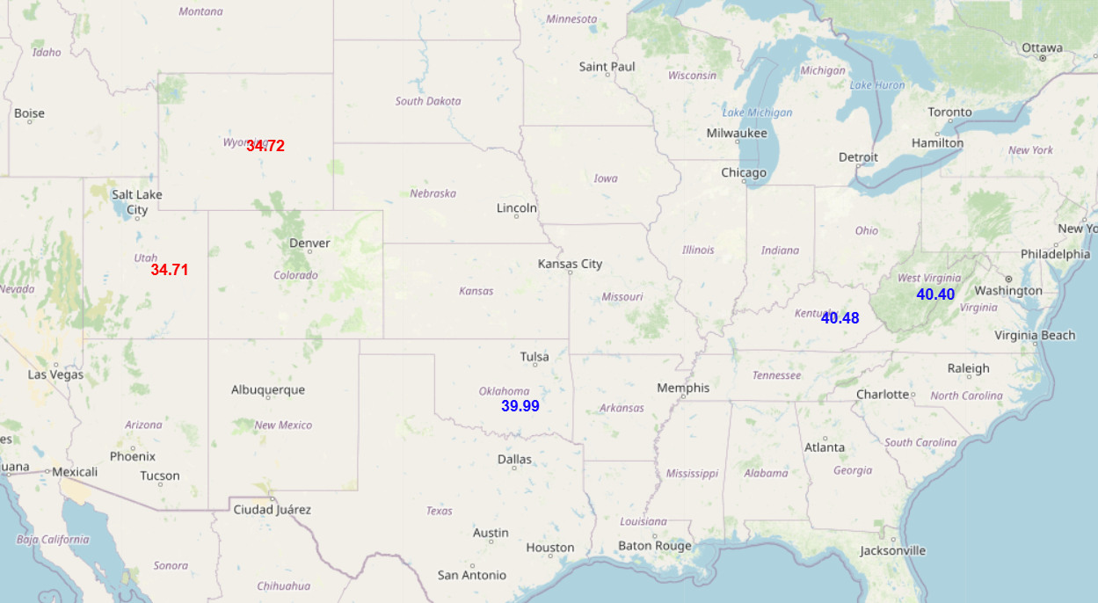

Slide 6
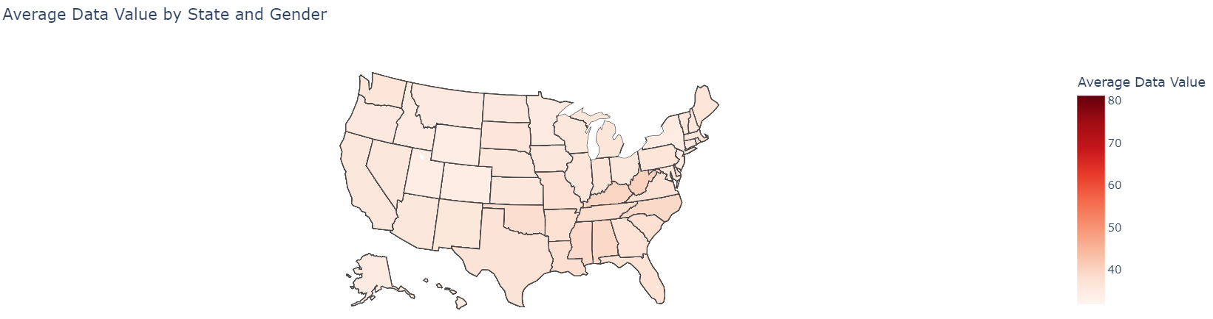

Slide 7
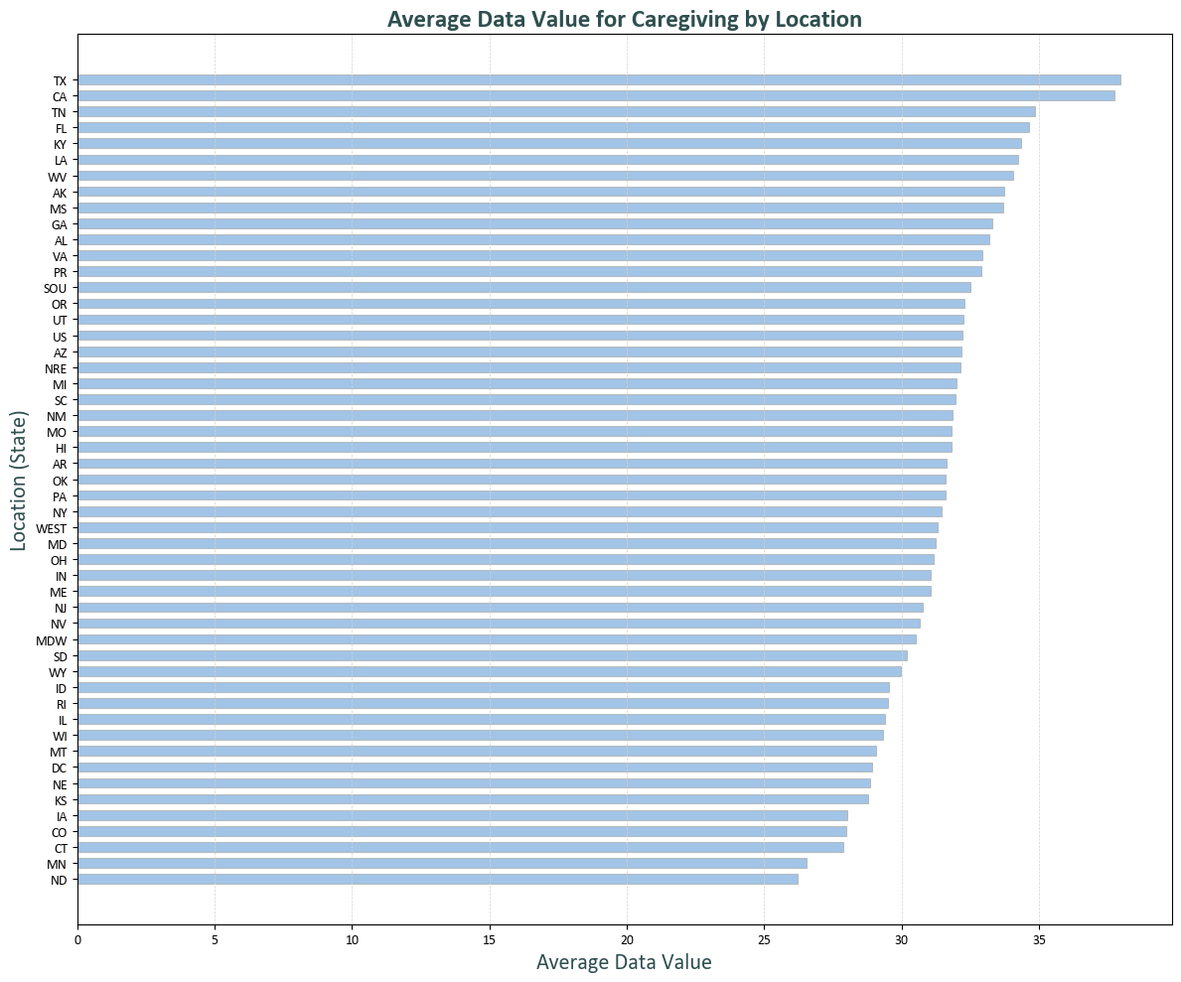
High Demand in TX, CA, TN: These states show the highest average caregiving needs.
Moderate Needs Nationwide: Most states have mid-range caregiving values.
Lower Demand in ND, MN: Certain regions exhibit reduced caregiving needs.

Slide 8
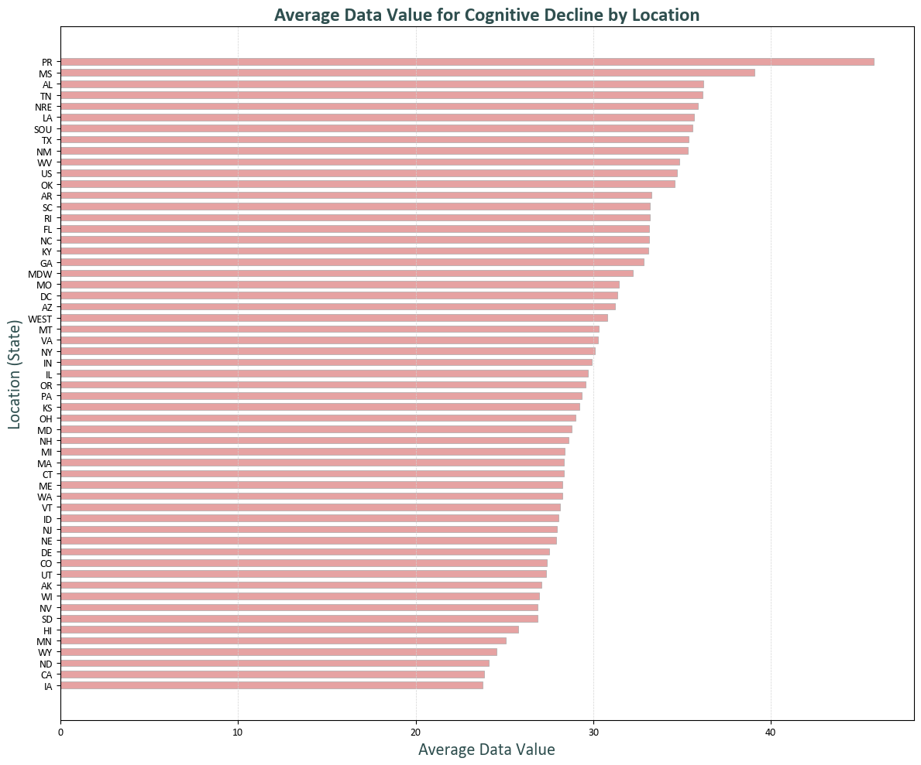
High Cognitive Decline in PR, MS, AL: Highest average values observed.
Broad Middle Range: Many states exhibit moderate levels of cognitive decline.
Lowest in CA, LA: These states show the least average cognitive decline.

Slide 9
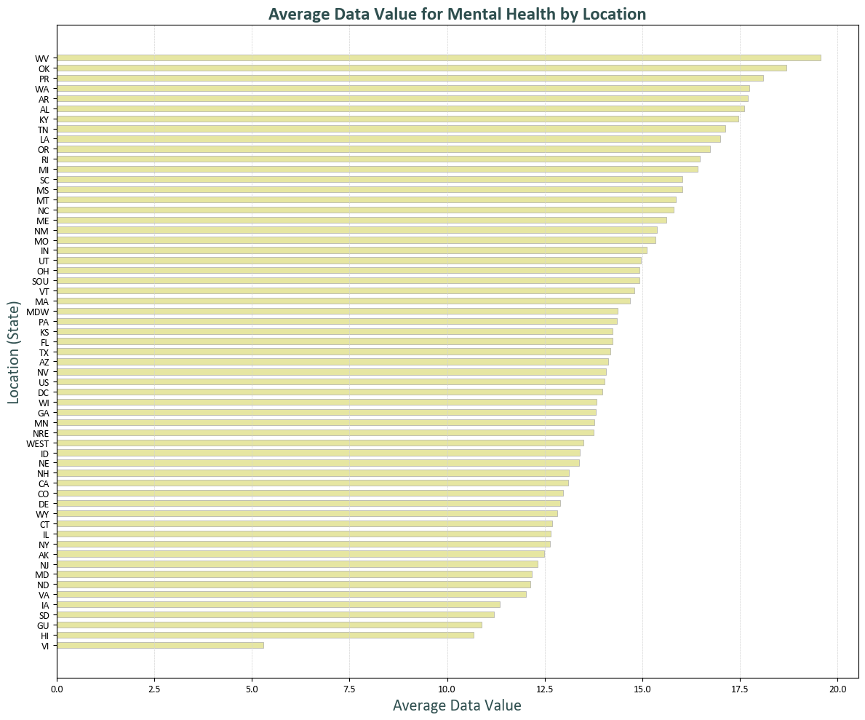
High Mental Health Needs in WV, OK, PR: These locations show the highest average values.
Consistent Moderate Range: Most states display mid-level mental health values.
Lowest in HI: Hawaii reports the lowest average for mental health concerns.

Slide 10
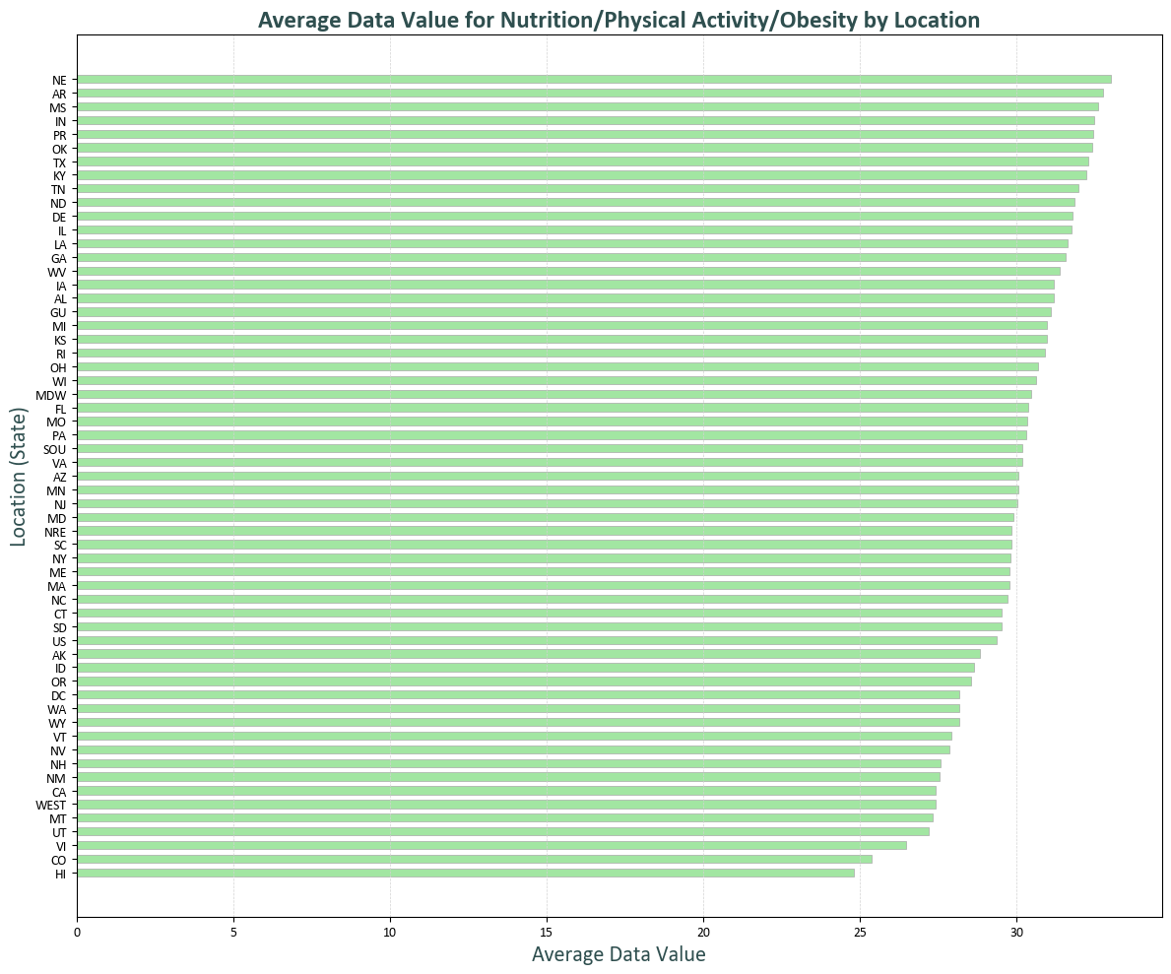
High Obesity/Nutrition Concerns in NE, AR, MS: Highest average values noted.
Moderate Levels Across Most States: A large number of states fall in the mid-range.
Lowest in CO, HI: Colorado and Hawaii have the lowest values.

Slide 11
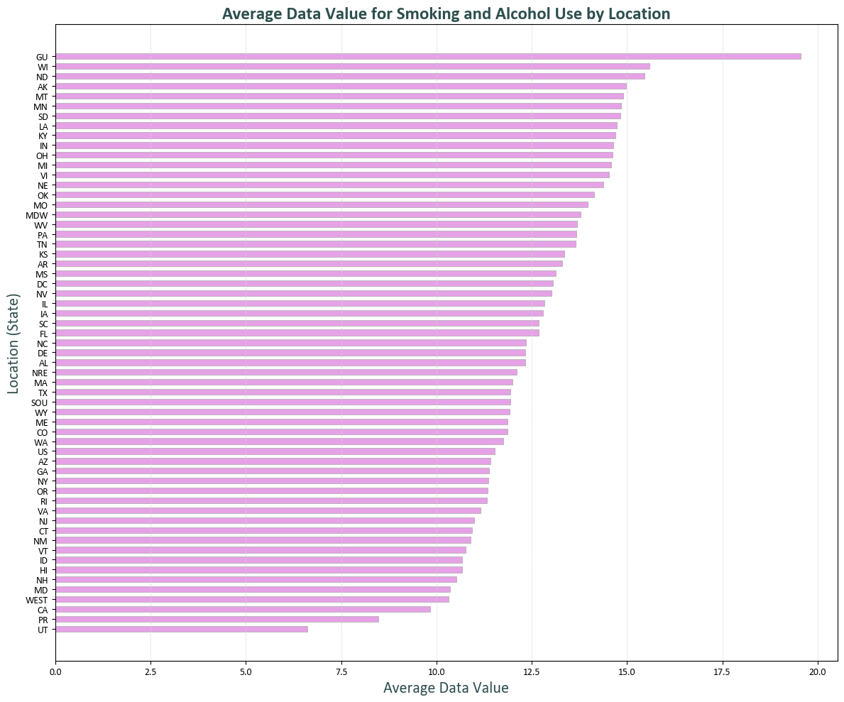
High Smoking/Alcohol Use in GU, WV, MD: Highest averages observed.
Moderate Levels Nationwide: Most states fall into mid-range usage.
Lowest in VI, PR: U.S. Virgin Islands and Puerto Rico report the lowest averages.

Slide 12

Data Value by Health Category
High-Risk Areas
"Screenings and Vaccines" has highest values, suggesting high healthcare engagement. This indicates proactive health management.
Risk Behaviours
Smoking and Alcohol Use has low average but remains critical for cognitive health. Targeted interventions may be necessary.
Resource Allocation
These insights inform where public health resources might best be allocated. Prevention strategies should focus on high-risk areas.

Slide 13

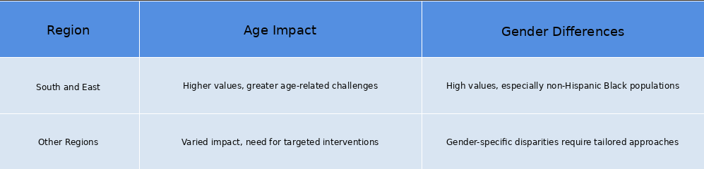
Geographic and Demographic Disparities

Slide 14

Caregiving Burden Across States
Texas
High caregiving burden, likely due to large elderly population. Increased demand for support services.
California
Significant caregiving needs, reflecting diverse demographic challenges. Resource allocation crucial for support programs.
Florida
Elevated caregiving demand, impacted by retirement population. Focus on respite care and caregiver well-being essential.

Slide 15




Cognitive Decline Hotspots
Puerto Rico
Highest cognitive decline data values.
Mississippi
Second-highest cognitive decline rates.
Funding Needs
Increased resources for cognitive health programs.

Slide 16

Mental Health Challenges
Washington
Highest mental health data values.
Alaska
Second-highest mental health challenges.
Resource Focus
Improved access to mental health services needed.

Slide 17




Obesity and Physical Inactivity
Nebraska
High obesity rates.
Arkansas
High physical inactivity values.
Alzheimer's Link
Obesity increases risk.

Slide 18

Preventative Health Success
1
Wisconsin
High screening and vaccine uptake.
2
North Carolina
Strong preventative health measures.
3
Effective Policies
Successful healthcare engagement in these regions.

Slide 19

Substance Use Concerns
1
Guam
Highest smoking and alcohol use values.
2
Indiana
Significant substance use challenges.
3
Kentucky
High rates of smoking and alcohol consumption.

Slide 20


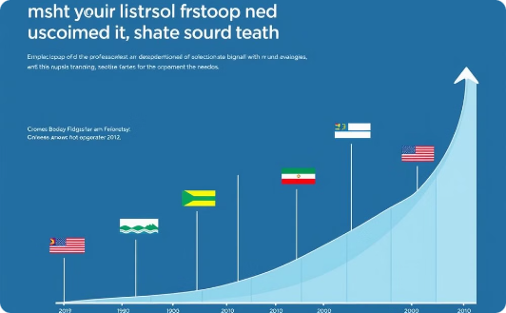
State Performance Benchmarking
Top Performers
Struggling States
Strategic Planning
Strong caregiving and mental health support
Proactive in screenings and preventive care
Promotes healthy lifestyle initiatives
Serve as model programs for other regions
Limited caregiving and mental health resources
Gaps in preventive healthcare access
High obesity and low physical activity rates
Need for targeted resource allocation
Data-driven resource allocation
Emphasis on preventive care
Tailored interventions per state needs
Collaboration with top-performing states for best practices

